Slide 2
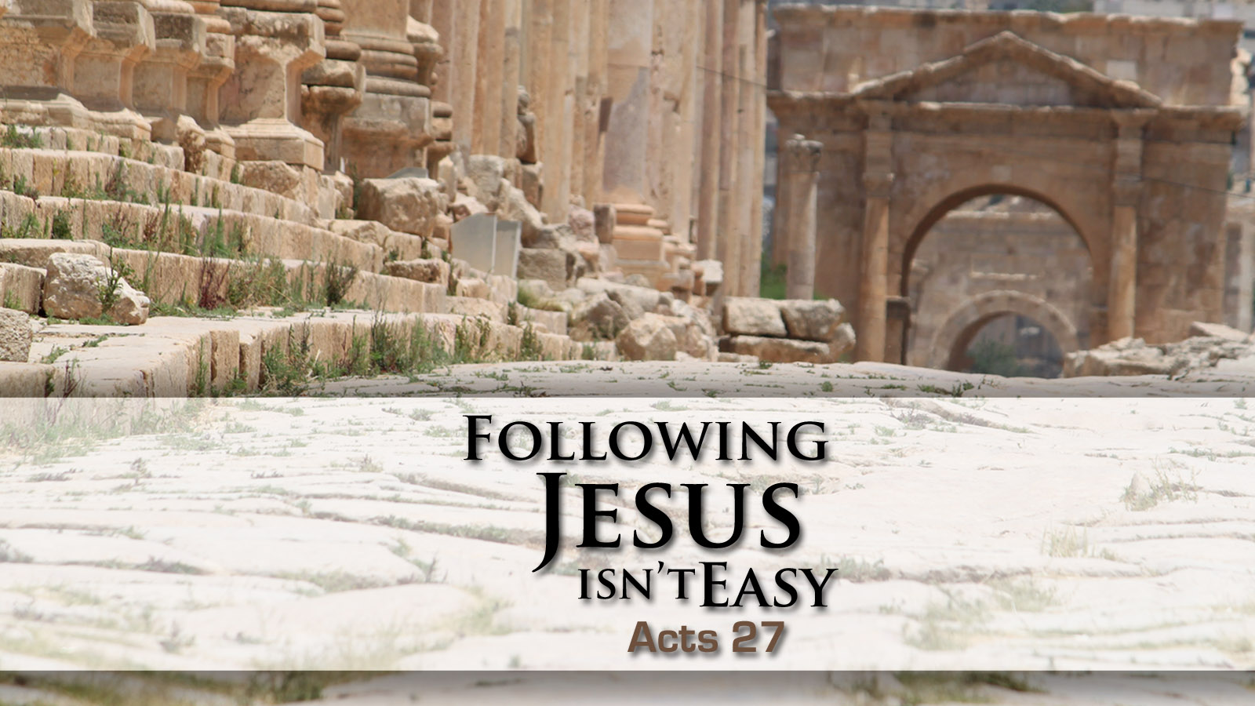

Slide 3
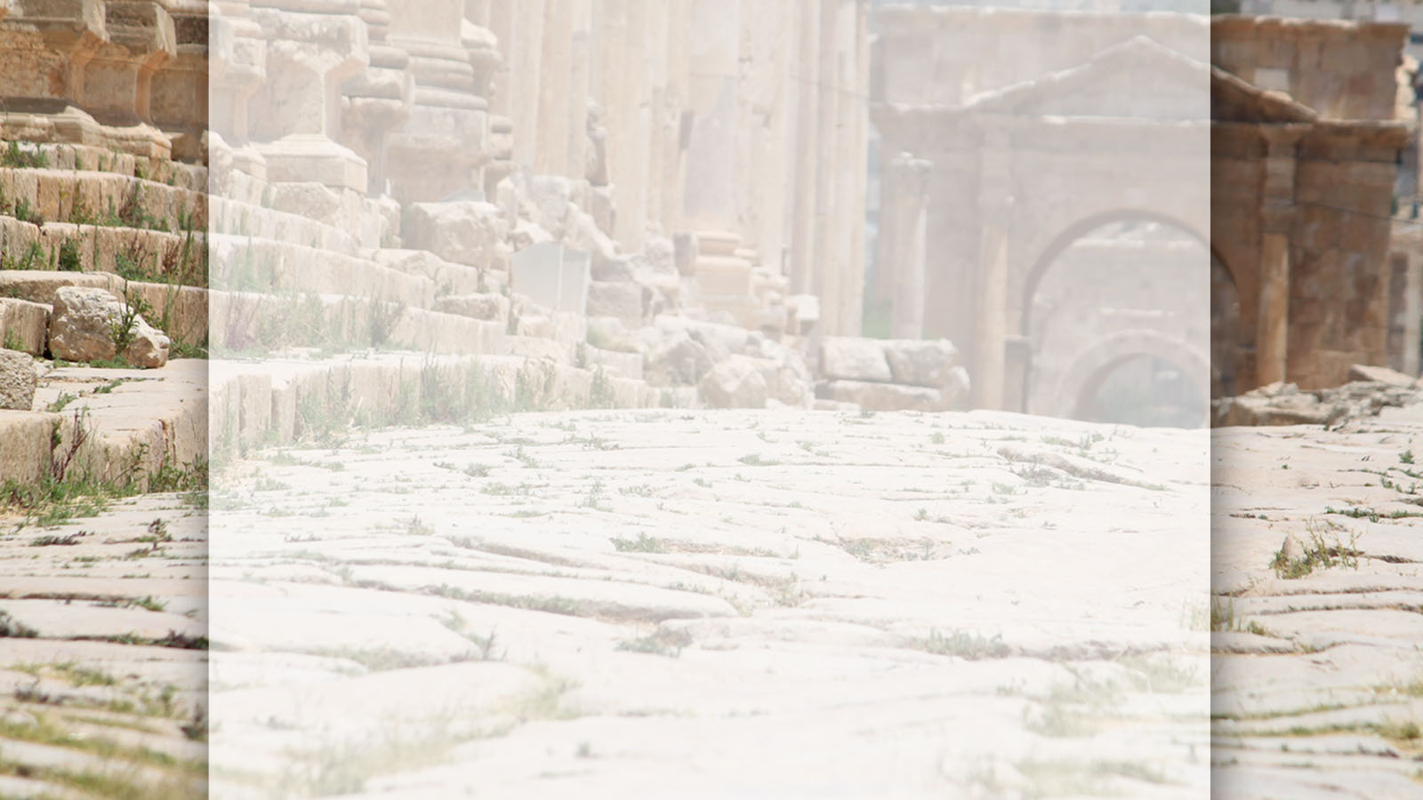


Slide 4
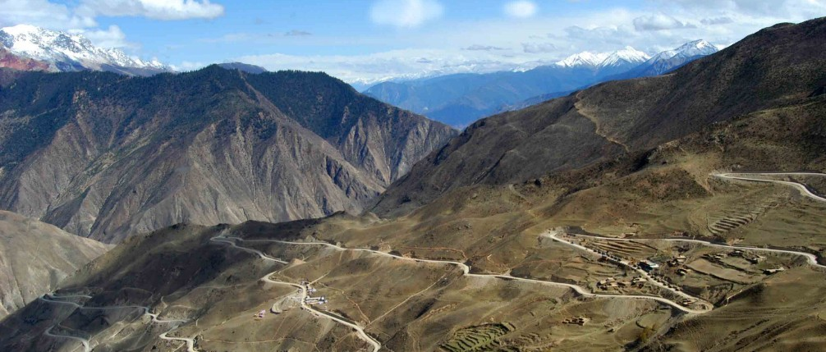

Slide 5
Following Can Be Difficult Acts 27:1-12

Slide 6
Following Christ Acts 9:16
“For I will show him how much he must suffer for the sake of my name.”

Slide 7
Following Christ Matthew 16:24, 26
Then Jesus told His disciples, “If anyone would come after me, let him deny himself and take up his cross and follow me…For what will it profit a man if he gains the whole world and forfeits his soul?”

Slide 8
The Christian life is not about convenience; it is about obedience.

Slide 9
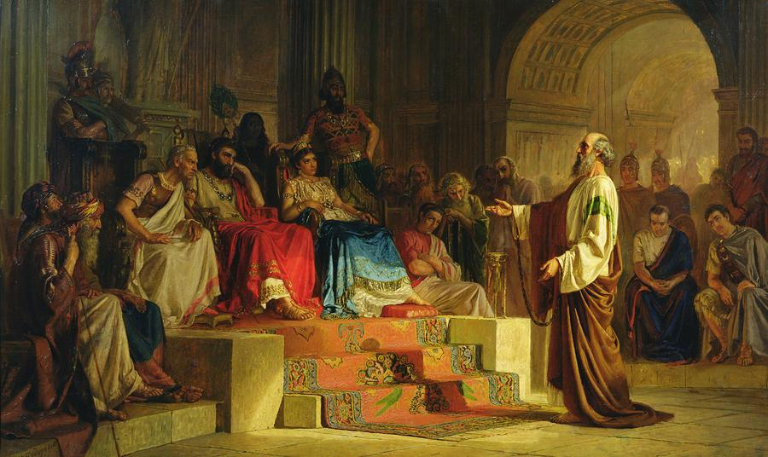

Slide 10
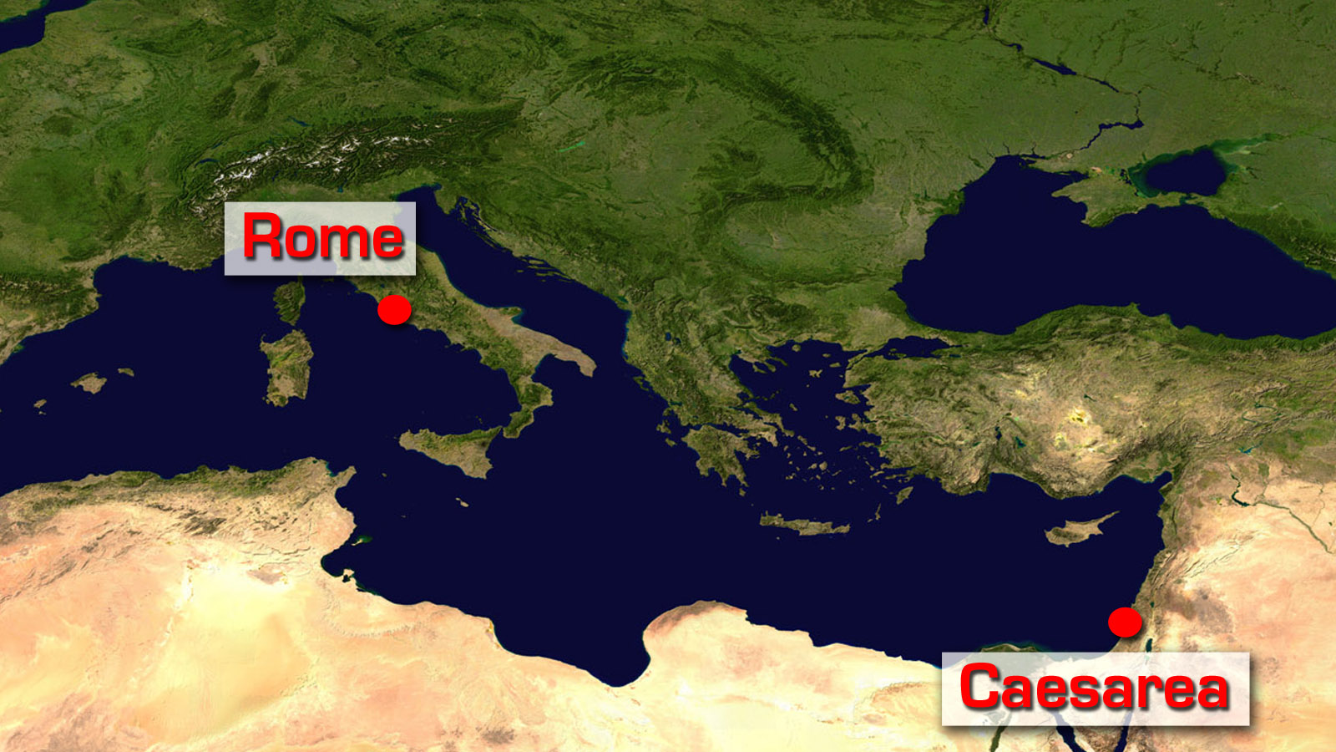

Slide 11
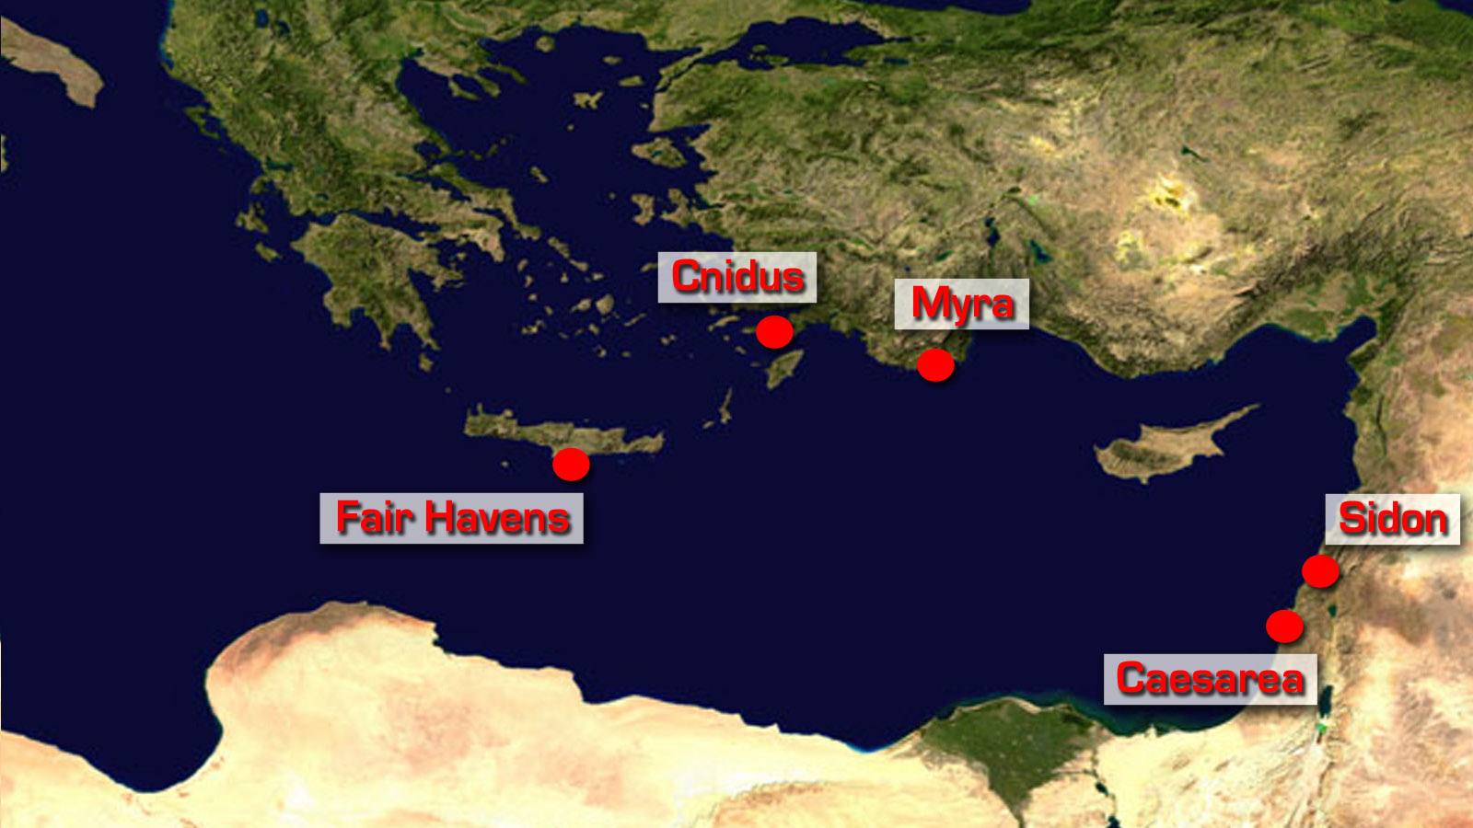

Slide 12
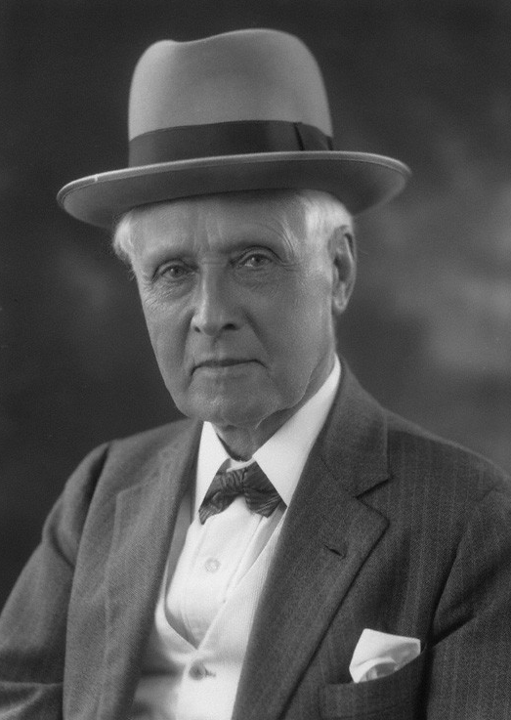
Sir William Mitchell Ramsay (1851-1939)

Slide 13


Slide 14
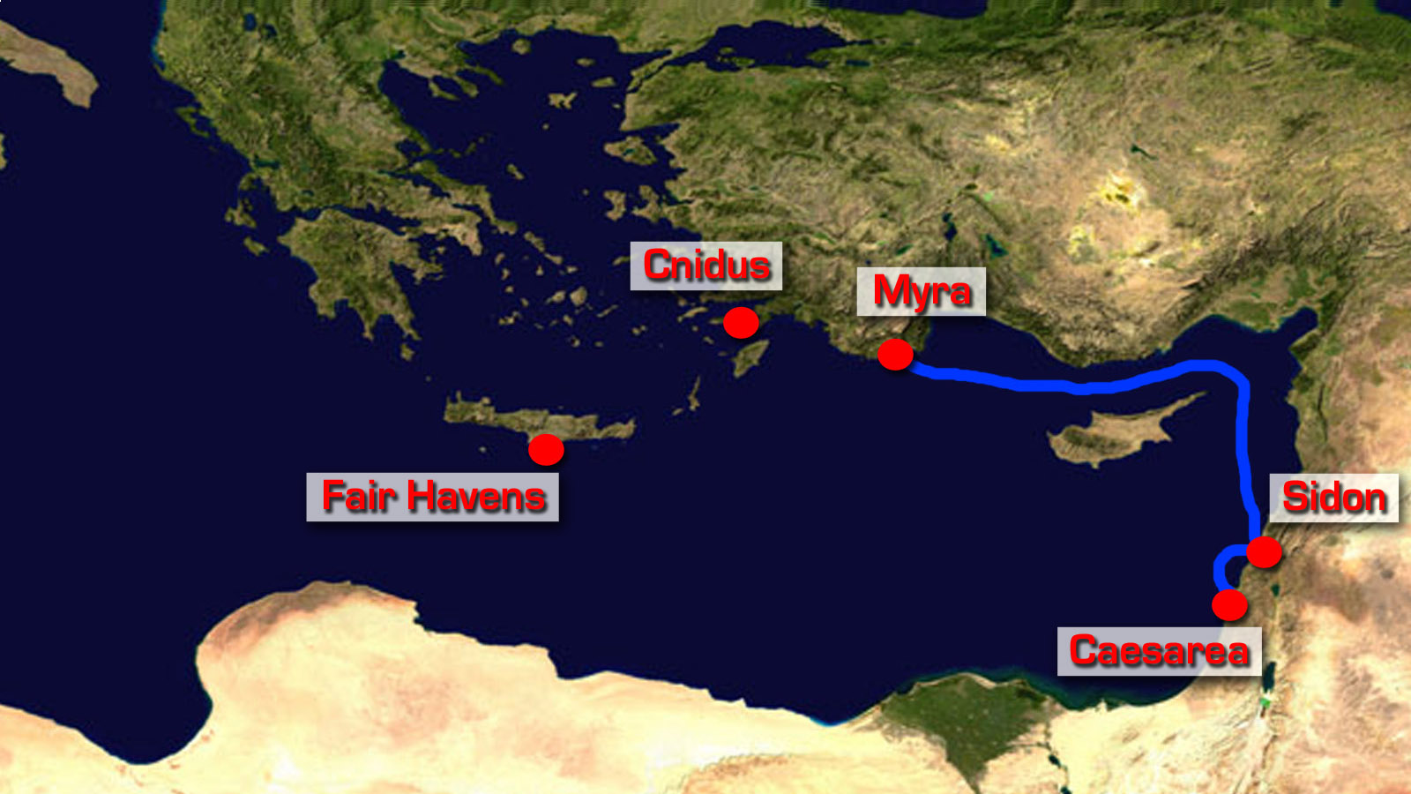

Slide 15
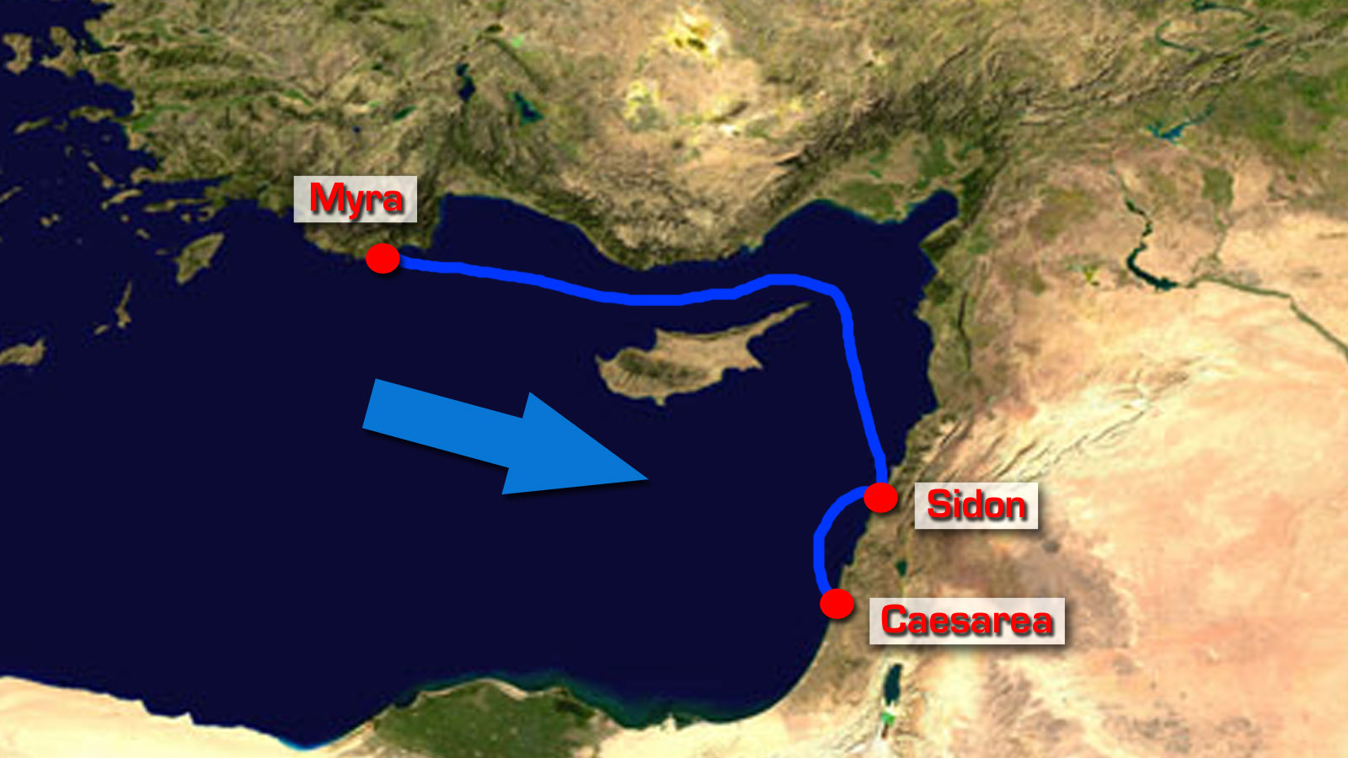

Slide 16
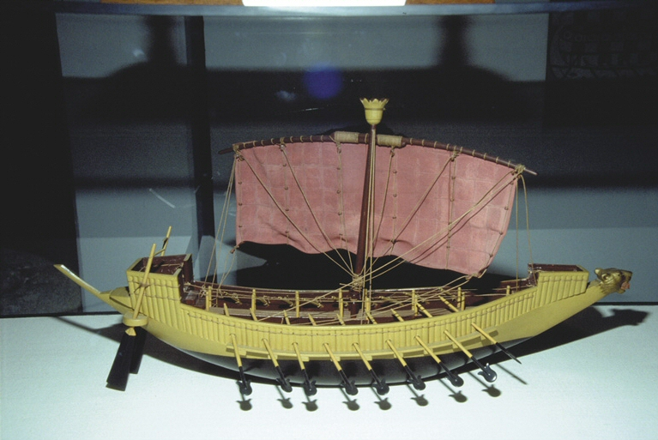
Alexandrian Grain Ship (Replica) (Length: 140-180ft)

Slide 17
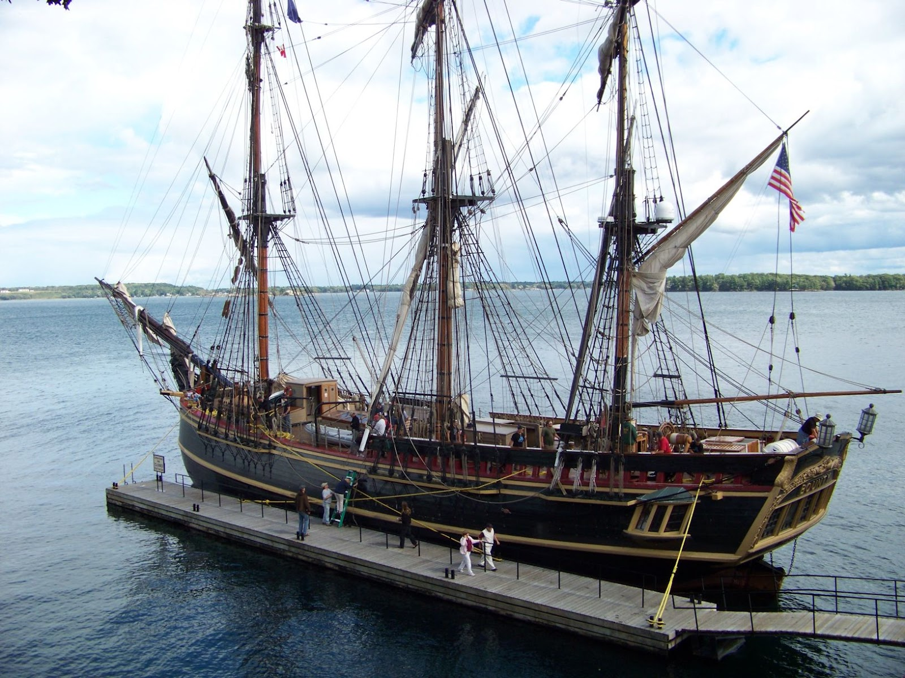
HMS Bounty (Length: 90ft)

Slide 18
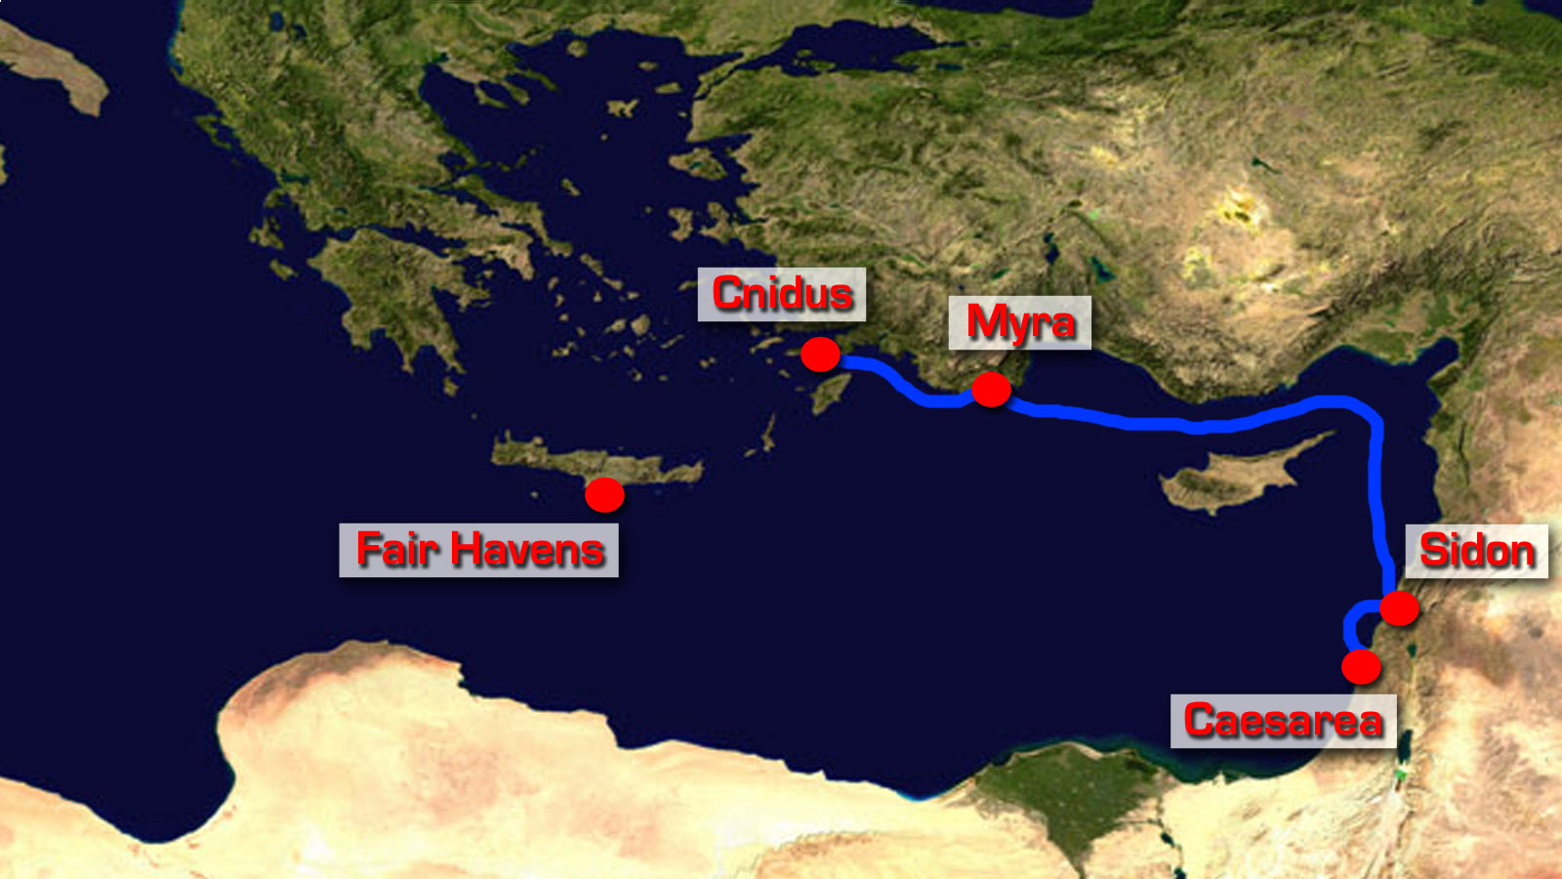

Slide 19
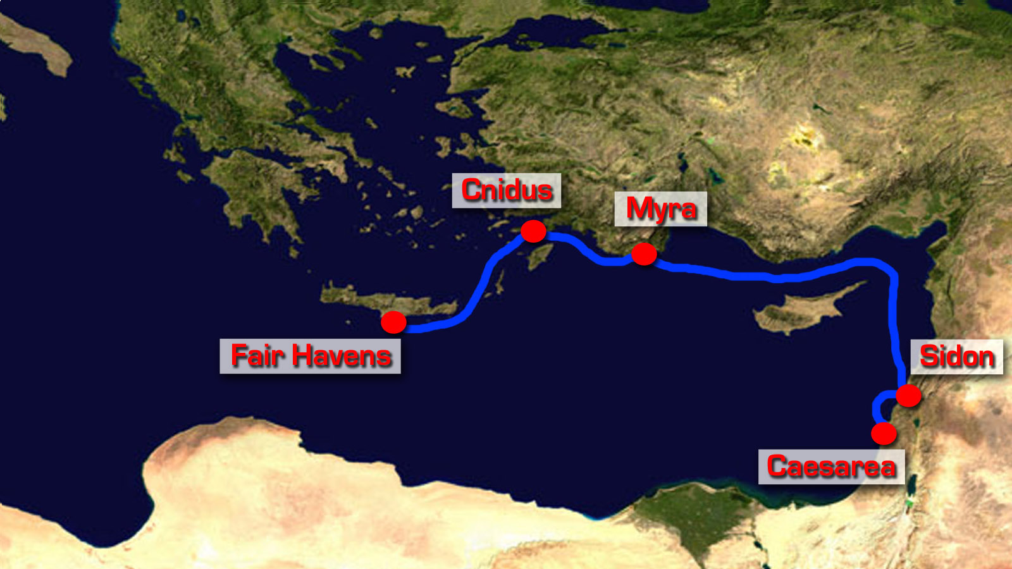

Slide 20
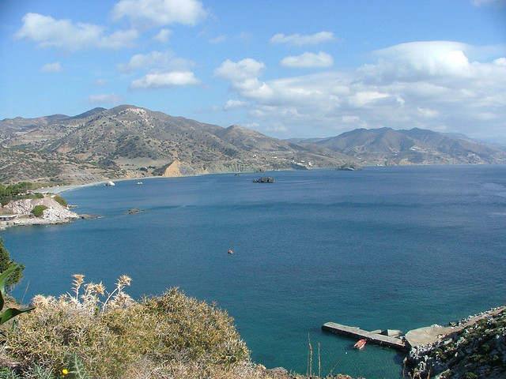
Fair Havens Crete

Slide 21
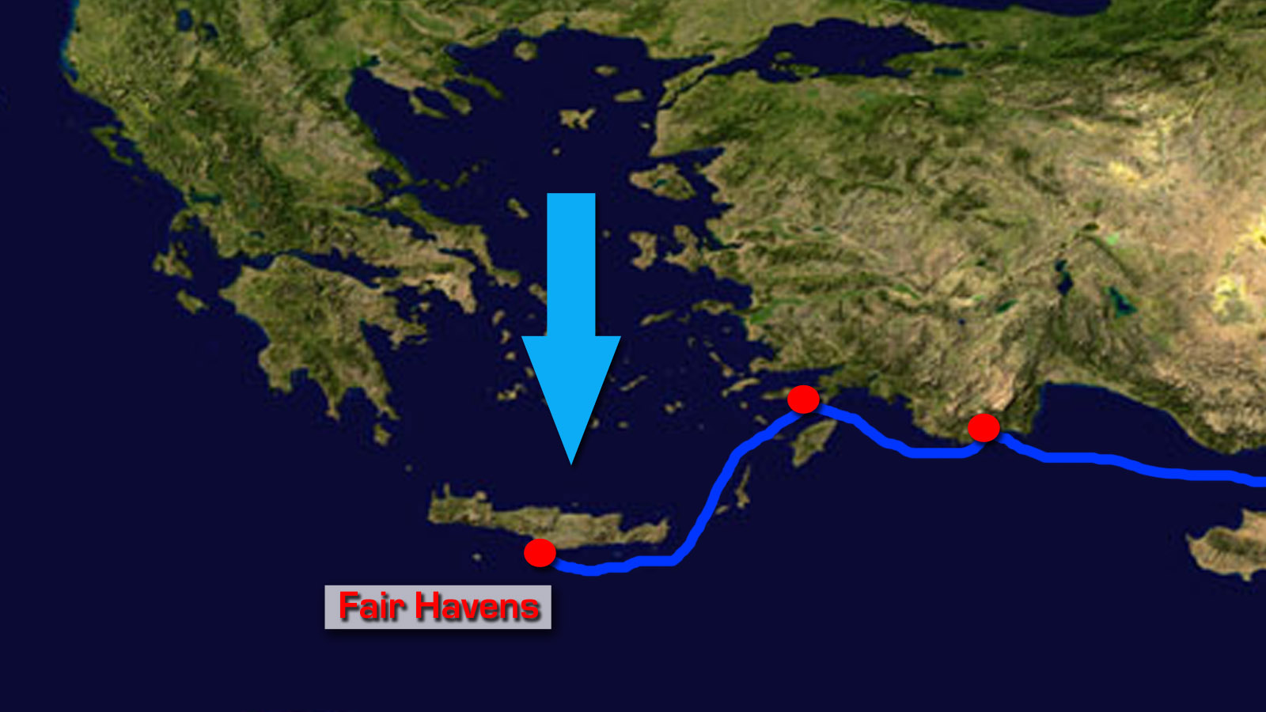

Slide 22
A Difficult Journey Acts 27:1-12
“…the winds were against us…”
“We sailed slowly…”
“…with difficulty…”
“…did not allow…”
“…with difficulty…”
“…dangerous…”
“...injury and much loss…cargo…ship…also our lives.”

Slide 23
Why? Acts 27:1-12
Why did Paul speak out? - When it would have been easy to say nothing, Paul spoke truth into the situation and he took responsibility.
Why is there difficulty in life? – Sin and death (Romans 5:12) and a determined, cunning, and powerful enemy (1 Peter 5:8, Ephesians 6:12).
Why does God allow difficulty? – Storms in life teach us to trust, trust produces steadfastness (James 1:2), and steadfastness produces worship. (1 Peter 1:3-7).
When will God do something? – God will bring total justice in His perfect timing (Ecclesiastes 12:13).

Slide 24
When Things Go From Bad to Worse Acts 27:13-38

Slide 25
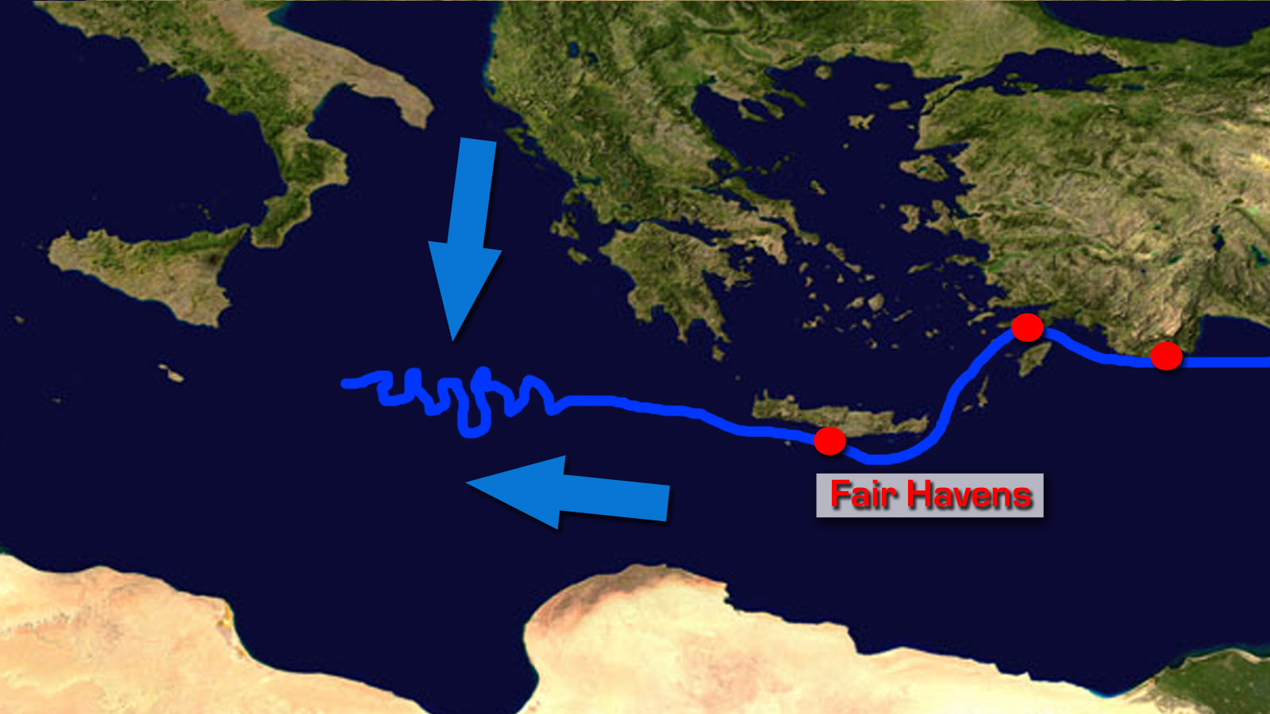

Slide 26
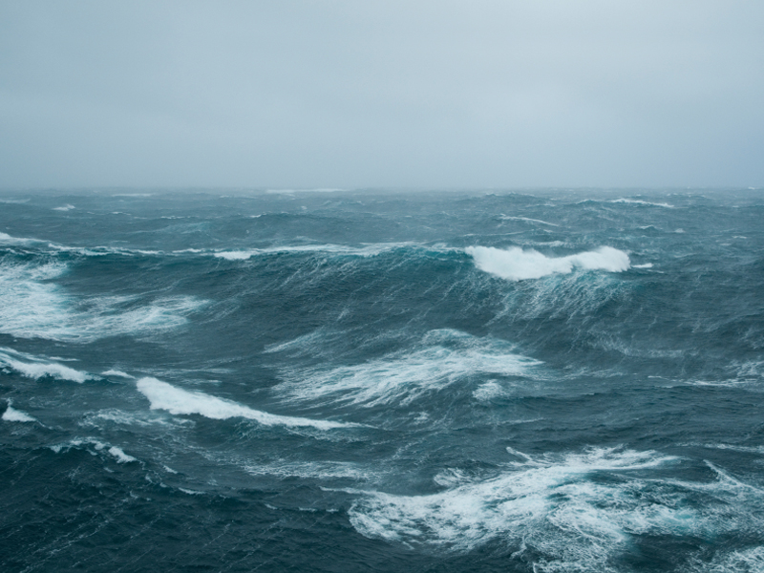

Slide 27
From Bad to Worse Acts 27:13-38
“…tempestuous wind…”
“…were driven along…”
“…with difficulty…”
“…fearing…”
“…violently storm tossed…”
“…no small tempest…”
“…all hope of our being saved was at last abandoned.”

Slide 28
Paul’s Maturity Acts 27:21-26
Paul’s wisdom is validated concerning the futility of the voyage in light of the weather and season of the year.
Paul knows there will be a major shipwreck, but he trusts in God’s presence, provision, and promises.
Paul demonstrates courage and leadership by speaking truth into the midst of a dire and hopeless situation.
Paul directs the men of the ship for the prosperity of the entire crew.

Slide 29
From Bad to Worse WHAT DO YOU DO???
STOP & REFOCUS. Get in the Lord’s presence.
GIVE THANKS. Give thanks for His love, grace, mercy, and His blessings, provisions, and hope.
RADIATE YOUR HOPE. Let the hope that you have in Christ radiate to everyone around you. The genuineness of your faith is validated by how you respond to the trials that you experience.

Slide 30
God’s Providence in the Shipwrecks of Life Acts 27:39-44

Slide 31
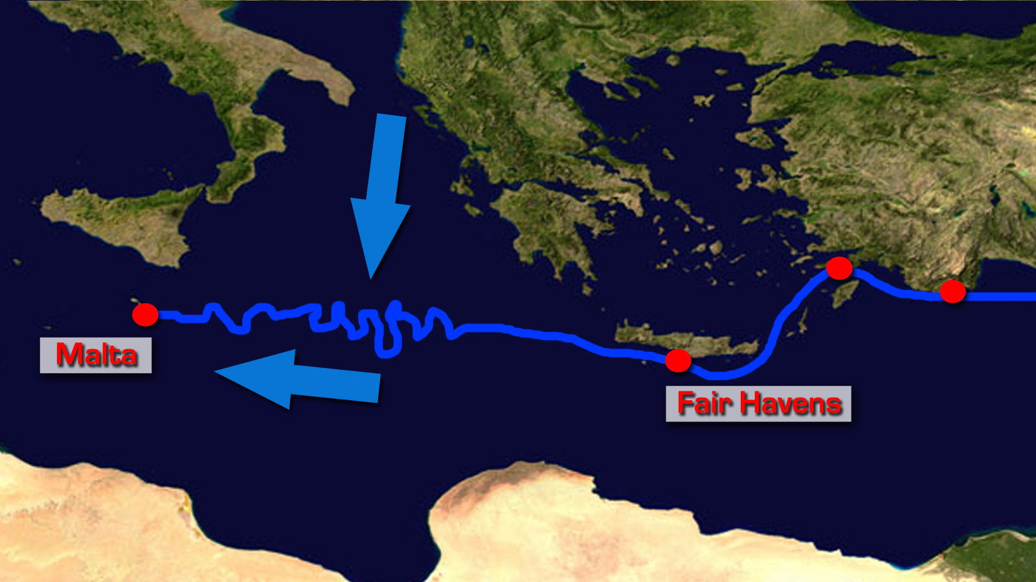

Slide 32
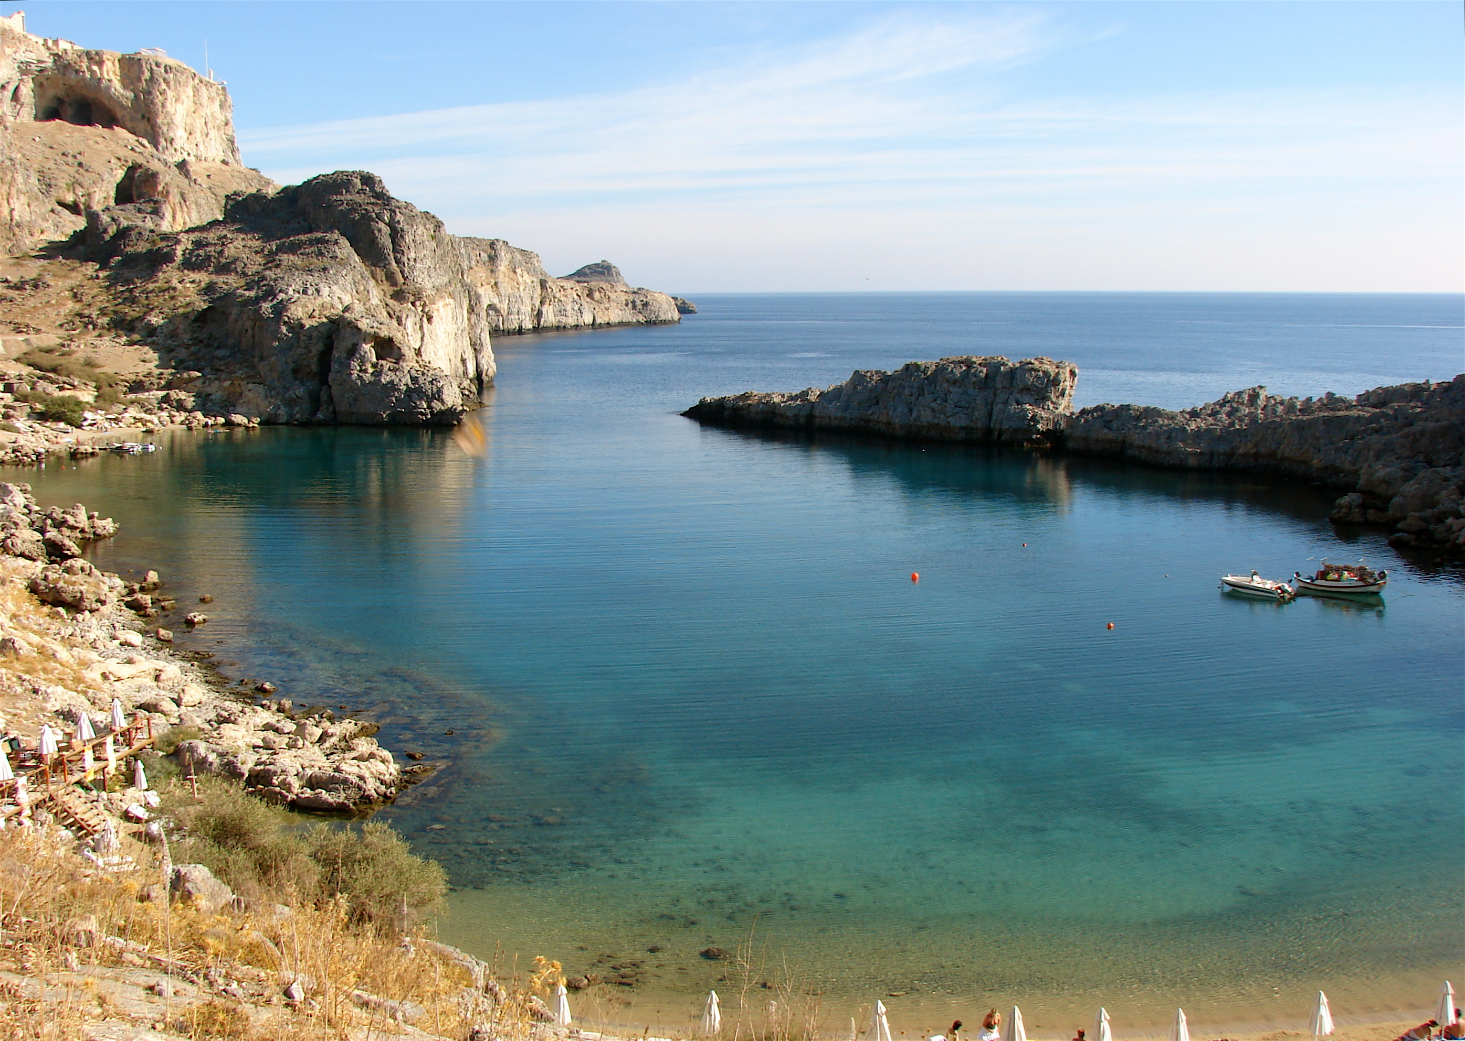
St. Paul’s Bay Malta

Slide 33
Paul’s Shipwreck See God’s Providence
God provided land.
God provided a beach.
God saved Paul through the Centurion.
God brought the entire crew safely to the beach on bits of debris in the midst of a hurricane.

Slide 34
Shipwrecks in Life Not the route we would choose.
Looking back, we see how God orchestrates His will. One day, the eternity of heaven will afford us with a clear view as to the “whys” of life.
Difficult times and shipwrecks in life show the nature and depth of our faith. When we are squeezed how do we respond?
Following Christ is not easy, but following Christ is definitely worth it.

